Slide 1
Exploratory Data Analysis
Web_ scraping project using Python Libraries

Slide 2
Contents:​
Introduction​
Problem Statement​
Data Collection​
Libraries used​
Raw Data and Clean data​
Data Cleaning​
Data Visualization​
Conclusion​

Slide 3
INTRODUCTION:​
Web scraping is a technique used to extract data from website with web you can gather information about PlayStation, games, reviews and prices​.
​Play Station is a popular gaming console developed and produced by Sony Interactive and since then, it becomes a significant player in the gaming industry​​.
Play Station has evolved with each new generation bringing advancement to immersive role playing games and thrilling sports​.

Slide 4
Problem Statement:​
Play station aims deliver cutting –edge technology, captivating games, and a platform for gamers t, and connect complete​.

Slide 5
Data Collection:​
URL-https://www.amazon.in​
We collect PlayStation 4 dataset from kaggle​.

Slide 6
Libraries used:​
Web scraping tools​ :-
Python​
Beautiful Soup​
Requests​
Data cleaning & manipulating​ :-
Numpy​
Pandas​
Data Visualization​ :-
Matplotlib​
Seaborn ​

Slide 7
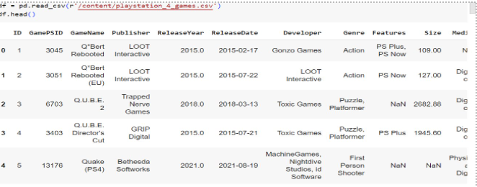
Raw data:​

Slide 8
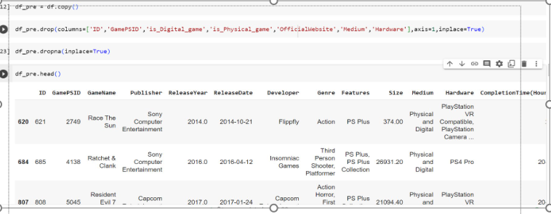
Data cleaning:​

Slide 9
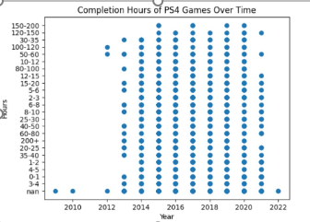

Data Visualization:​

Slide 10
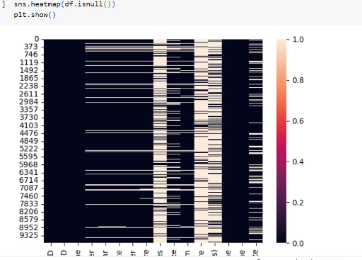

Slide 11
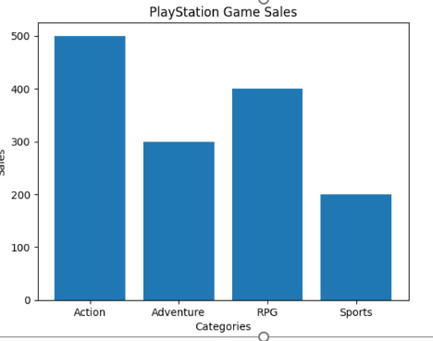
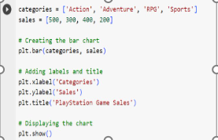

Slide 12
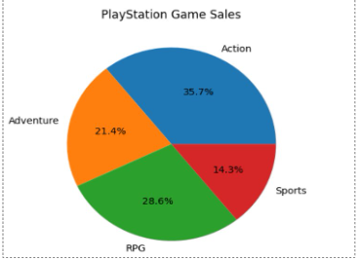
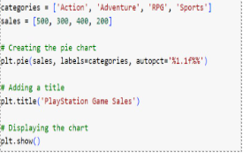

Slide 13


